Slide 1

Business Case Cambodia
July 2016

Slide 2
Investment Summary

Slide 3
Investment Summary
Main characteristics consumer finance market of Cambodia:
1) Stable economic growth - around 7% yearly in last 4 years , low unemployment rate – 0.4%
2) Liberal consumer finance regulation :
a) No interest cap by banking law ( liberalization interest rate law Prakas #B7-09-213 by Central Bank Cambodia )
b) With local expertise in place, we should be able to start business in August.
3) 25% employee out of 8,6 million labor force have credit history in Credit Bureau of Cambodia. There is a government target to increase number of employees with credit history to 42% by 2020.
4) One of the highest levels of telecom development: mobile penetration – 155%, smartphone penetration – 39% out of mobile penetration.
5) 3 biggest cell operators in Cambodia have own payment systems. Every mobile phone user has more than one mobile wallet.
6) Undeveloped consumer banking industry:
a) Bank account penetration is 13%
b) credit cards penetration is 3% (Customer have to make deposit - 150% of credit limit required)
Key success factors in the market:
No interest cap
150% mobile wallet penetration
Smartphone penetration 60% (growth of 15% per year)
We believe that Cambodia market has a lot of opportunities in nearest 2-3 years. We can be one of the first players who will provide fast and easy loans.

Slide 4
Investment summary
Investment summary |  |  |  | Timeline
thsd USD |  | Year 1 | Year 2 | Year 3 | Year 4 | Year 5* | Total
investments |  | 205 | 1 184 | 662 | 268 | 0 | 2 318
Total investments |  | 205 | 1 184 | 662 | 268 | 0 | 2 318
Number of loans issued (thsd) |  | 5,6 | 36 | 72 | 144 | 288 | 546
Amount disbursed |  | 540 | 3 423 | 7 684 | 13 871 | 19 182 | 44 700
Net portfolio (EoY) |  | 135 | 663 | 1 424 | 2 425 | 3 078 | 3 078
Revenue |  | 738 | 1 508 | 3 581 | 6 812 | 10 104 | 22 743
Net profit after taxes |  | -120 | -696 | 609 | 1 553 | 2 990 | 10 739
ROE (yearly) |  | -7% | -16% | 11% | 25% | 49% | 50%
ROAA (yearly) |  | -13% | -28% | 14% | 23% | 32% | 37%
Break-even period – 18 months.
Payback period – 51 months.
Maximum investments from – $2,3M.

Slide 5
2. Market Overview

Slide 6
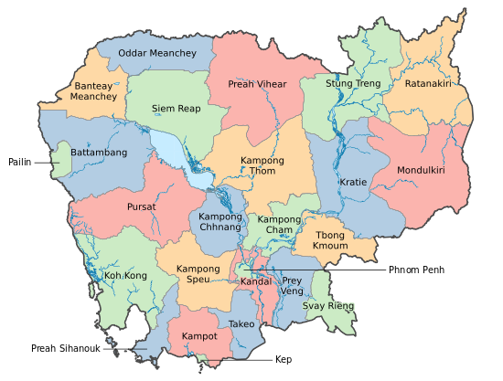
General Market Information
parameters | 2014 | 2016 | Growing, %
Population Cambodia | 15.4 mln | 15.7 mln | 1.6%
Population Phnom Penh | 1.51 mln | 1.59 mln | 5.2%
Cambodia labor force | 8.45 mln (2013) | 8.62 mln (2014) | 2%
Unemployment rate | 0.4% | 0.4% | 0
GDP per capita | 1096 usd * | 1240 usd | 13%
Salaries rate Cambodia | 152 usd | 190 usd | + 25%
Salaries rate Phnom Penh | 190 usd | 250 usd | + 31%
Urban population | 21% | 23% | + 9 %
Mobile penetration** (including smartphones) | 126% | 155% | + 29 %
Smartphone penetration** (out of mob. penetration) | 29% | 39,5% | + 36 %
Facebook penetration Facebook accounts | 16% 2,5 mln people | 22% 3,4 mln people | + 37,5 %
Bank account penetration | N/A | 13%
E-wallets penetration | <1 000 000 | > 6 000 000 | + 600%
Capital of Cambodia – Phnom Penh, Official languages – Khmer
Ethnic groups –
90% Khmers, 5% Vietnamese,
1% Chinese, 1% other
1) Average income in Cambodia close to Vietnam and keeps increasing
2) E-wallet penetration is one of the highest in Asia. since in 2016 mob operator SMART launched own payment system for 6 mln subscribers. Market share of SMART more than 60%.
3) Stable GDP growth (around 7% yearly). Unemployment rate is one of the lowest in Asia.
* source of information - https://knoema.com/sijweyg/gdp-per-capita-ranking-2015-data-and-charts
** source of information – https://www.techinasia.com/talk/digital-southeast-asia-q4-2015

Slide 7
Consumer Finance Industry Landscape
Consumer lending in Cambodia is performed by Banks, MFIs, NGOs Rural Credit Operators and Pawnshops . At the same time, there are still a lot of unlicensed money lenders.
Cambodian Banking system was established in 1979. Government allowed international investors involved 100% of their capital on the bank financial institution. Most of banks concentrate on SME segment. At this moment in country working 36 banks, include 8 international.
MFI can be two types: deposit taken or credit only. Now there are 6 deposit taken MFIs and 64 credit in Cambodia, with more then 2000 branches. Total MFIs loan portfolio is 3.4 bln. usd and 2 mln borrowers. Deposit portfolio is 1.45 bln. usd.
Historically this MFIs use as money laundering schemes. Cambodia is the third most at-risk country to money laundering (2014)*
In beginning of 2016 paid up capital for MFIs was seriously revised from 62 000 usd to up 1.5 mln.
MFI provide loans in Cambodia with collator or guarantors. Lending process still difficult for clients. Approval process: from 2 days to 2 weeks.
One more subject of consumer lending market is Rural Credit Operator working as NGO. Government wants to control this grey area of market and decide to push them to register as MFI. In end of 2015 National Bank of Cambodia received more then 400 applications for registration. Government cannot conduct so much comprehensive inspections, that’s why NBC approved only 44. NGOs still providing loans, but impossible to create a new one.
Until 2009 there no requirements for pawnshops to have a license. In 2009 government introduced licensing process for pawnshops. In last 5 years more then 300 pawnshops received the license, but more 1000 still operating without license.
Consumer lending market regulated by National Bank of Cambodia and Ministry of Economic and Finance which regulate pawnshops activity. (annex: Governing bodies in Cambodia )
Banks are focused on SME lending, long and complicated process of borrowing money from the banks for individuals.
Consumer lending is represented by NGOs, MFIs, cooperatives, pawnshops and unofficial money lenders
We can we can realize our business model like pawnshop.
* https://www.cambodiadaily.com/archives/cambodia-vulnerable-to-money-laundering-67363/

Slide 8
Licensing Options
Parameters | Commercial Bank |  | MFI | NGO (Rural credit operator) | Credit co-operative | Pawnshops | P2P
Main purpose | Full-range banking services for retail and corporate clients |  | Lending activity | Lending activity in rural area | Lending activity strictly in rural area | Lending services with collateral (we are not forced to take collateral) | Crowd lending Crowd funding
Minimum paid-up capitalization | $70 mln |  | $1.5 mln | $62 500 | $15 000 | $30 000 | Not regulated
Max foreign capital share | 100% |  | 100% | 0% - local NGO 100% - foreign NGO | 0% | 49% | 100%
Products | Loans, Deposits Credit cards |  | Deposits Loans | Loans | Loans | Collateral’s loans | Not regulated
Interest cap | No restrictions |  | No restrictions | No restrictions | No restrictions | No restrictions | No restrictions
Regulator | National Bank of Cambodia (NBC) |  |  | Ministry of foreign affairs (foreign NGO) Central Bank (Rural Credit operator) | No government regulator yet. Now only self-regulatory | Ministry of Economic and Finance | No regulator.
Term for getting license | 2 years | 6 months NBC not issuing any new licenses |  | Not providing (since 08.2015 ) | No license | 40 working days | No license
Number of licenses | 36 | 70 |  | ~ 400 | 60 | ~ 300 >1000 unofficial
Optimal choice in licensing options is Pawnshop + P2P

Slide 9

Market Size Estimation
Our plan is to reach 850 loans disbursed per day in 2020.
Mln USD
 | 2016 | 2017 | 2018 | 2019 | 2020
Our disbursement volumes, mln. USD | 0,5 | 3,2 | 6,48 | 12,9 | 29,9
Our Number of loans (thousand) disbursed per year | 5,6 | 36 | 72 | 144 | 288
Main assumptions:
Yearly market size growth – 7%
Our market share in 2020 is expected to be ~0,5% of MFI loans and Money Lenders.

Slide 10
3. Legal Setup

Slide 11
Critical Business Model parameters Key regulatory points of PAWNSHOP and P2P
# | Sphere of regulation | Pawnshop | P2P
1 | New licenses issuance by regulator | Licensing process taking 40 working days. Foreign company can not have more than 49% of pawnshop company. | Not regulated
2 | Allowed credit products | Loans with collateral. As collateral can be any document, not specified - copy or original. One of our proposal: to take copy of “National ID” as collateral. | any
3 | APR/EIR interest cap | There is no interest cap for financial institutions. (Prakas No. B7-09-213P on the Liberalization of Interest Rate by Central Bank) In court we can not charge more than 27% per annum. (Prakas No. 128 MOJ.P/11 on Determination of Interest Rate by Ministry of Justice ) Nevertheless, if the case in court, legal fees can be charge from the customer. | Not regulated. Private persons is not a financial institutions. Only court can limit interest rate. (legal opinion)
4 | Advertising requirements | No restrictions | Not regulated.
6 | Face-to-face customer verification | No regulation directly in law | Not regulated.
7 | Remote contract signing | No regulation directly in law | Not regulated.
8 | Debt collection | There is no legislation | Not regulated.
9 | The funding of the loan portfolio | Could be financed through loans directly from parent company in Singapore. | Directly by peers
We entered Cambodia market using Pawnshop license – as a simplest licensing option in terms of obtaining the license. Also we will use LGC company as p2p platform to attract funds (big gap between bank deposit and loan interest rate)
Link on legal opinion : https://goo.gl/8yfTC4

Slide 12
Pawnshop Regulation
Regulator:
Ministry of Economic and Finance
Document regulating Moneylending:
PRAKAS On Licensing Pawn Business, # 028 SHV PRK . 12 Jan 2010
Mandatory documents for Pawnshop:
The Pawnshop License
Regulation practice:
Regulation of Pawnshop is not strict comparing to MFI one, which is regulated by National Banc of Cambodia. Which reflects in a relatively low required capital (30 000 usd) and easy procedure to get license.
Company must extend license one time per year. Ministry of Economic and Finance officials can make review of pawnshop activity (check pawnshops documentation, and collateral keeping.
Foreign company can not have more than 49% of pawnshop company.
No restrictions on funding. Could be financed through loans directly from parent company in Singapore.
We entered Cambodia market using Pawnshop license – as a simplest licensing option in terms of obtaining the license. Also we will use LGC company as p2p platform.
Notes:
Ответ от Rajah & Tan

Slide 13
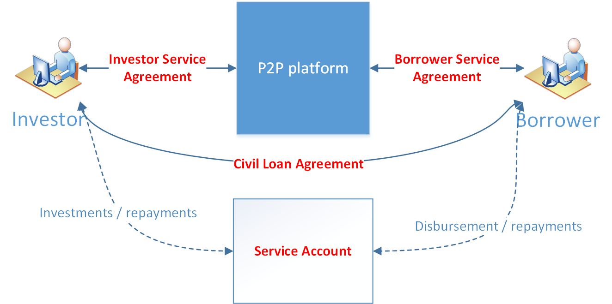
P2P development phases
We plan to develop P2P platform using the following phases:
Phase 1. PAWNSHOP – we are the lender and investor (Q3’2016)
Phase 2. PAWNSHOP + P2P – multiple individual investors (Q4’2016)
Phase 3. PS+P2P – individual and institutional investors (in 2017)
After the service grows we plan to provide institutional investors possibility to invest in our service.
Start with set up pawnshop as moneylender
At this phase we plan to present new credit products (for example, installment loans) as we will receive respective funding from institutional investors.
At this phase we also plan to present a “deposit-guarantee” mechanism and a separate “Investor” product.
After finishing development of the Web-portal for individual investors we will start acquiring independent individual investors from the market to raise funding.
Starting to build Web-portal with p2p platform
Platform will obtain its profit through charging Investor with a set of fees, basing on service agreement.

Slide 14
Appendix 2. P2P Business Process
Business Process
4
3
2
approves/rejects
Loan application
1
sends the loan application
to LENDER
publishes the
Approved loan applications
INVESTOR
funds the
Loan application
LENDER
Pawnshop
INVESTOR
P2P
platform
LENDER
Pawnshop
Borrowers
INVESTORS
LENDER
Pawnshop
LENDER
Pawnshop
Data checking
verification

Slide 15
Appendix 2. Mekar Exchange Case Study (P2P) Cash Flow and Pricing (Cont)
Cash flow
1
2
3
Transfers the funds to
account in P2P platform
Per Lender’s request transfers
the funds to the Pawnshop
Transfer the funds to the
final Borrower
INVESTOR
INVESTORS
P2P
platform
LENDER
Pawnshop
Borrowers
LENDER
Pawnshop
LENDER
Pawnshop
transfers
the funds to the Lender
Transfers the funds to
P2P bank account
Repays the loan
6
5
4
Contractual Obligations
T&C
Accepting via web
Service Agreement
Loan Agreement
INVESTOR
INVESTORS
P2P
platform
LENDER
Pawnshop
Borrowers
LENDER
Pawnshop
LENDER
Pawnshop
Loan Agreement

Slide 16
4. Product & Marketing

Slide 17
Consumer Lending Landscape
Type | Product types | Annualized EIR | Loan Amount | Tenure | Verification | Time-to-Money | Target Customers
Bank | Secured loans Business loan Individual loan Credit Cards | Up to 24% | Up to $3000 | Up to 25 years | ID Salary proof Address proof Collateral or guarantor or guarantee letter | Up to 10 days | Official employees and entrepreneurs, who can provide guarantor or collateral
MFI | Secured loans Business loan Individual loan Credit Cards | From 18% up to 48% | $50 – $500 | Up to 60 months | ID Salary proof Address proof collateral or guarantor or guarantee letter | From 2 days up to 2 week (based on loan amount) | Official employees and entrepreneurs, who can provide guarantor or collateral.
Pawnshop | Collator loans | Up to 120% | $10 - $300 | Up to 4 months | ID, Collateral | 1 hour | All types of clients who can provide collateral
Unofficial lender | Individual loans | From 240% - 720% | $30 – $100 | From 1 week up to 1 month | ID, address proof, recommendation from other client | 1 hour – 1 day | Customers without official work or clients who need emergency money and can’t provide collateral
Our Target audience is customers who need emergency loan and don’t want provide collateral. Our main competitors are unofficial lenders and pawnshops.

Slide 18
Our Strategy
# | Parameter | Pawnshop | LoanSharks | Our Offer
1 | Loan amount range | $10 - $300 | $30 – $100 | $30 – $150
2 | Average loan size | $90 | $60 | $90
3 | Average tenor | 3 months | 1 month | 27 days
5 | Collateral | Needed | No need | No need
6 | Effective IR rate per year | 18%-120% | 240%-720% | 365%
7 | Late fee | No data | No data | 2% per day
8 | Prolongation fee | No | No | No
9 | Time to money | 1 hour | 1 hour – 1 day | 1 hour
10 | Loan disbursal | Cash in pawnshop office | Cash in hand | Payment systems
11 | Verification | ID | ID, Recommendation by existing client | ID, Employment, address, Credit Bureau check, Phone verification
12 | Business model | Offline | Offline | Online to offline
Our strategy – we will focus on fast loan delivery and comfortable repayment process (remote via payment system), we not required collator

Slide 19















Initial Sales Business Process (O2O)
Application
Decision
Contract signing:
Loan agreement
Acknowledgement of Fees ( LGC )
Agreement for debt collection
Loan granting
Functionality already available in Terrasoft and planned to be used
New functionality&Integrations to be implemented in Terrasoft
SMS Gateway
ID Checking
acounting
Terrasoft
investors «peers»
SMS campaign
Customer
Work place
Contact persons
$
BANKS with payroll service
Transfer to borrower's bank account
From our investor`s bank account
$
Outbound call
General stop factors check
Call Center verification
Data checking
Loan granting
Transfer to customer’s bank account
Inbound call
Pre-Approval
Additional information required
Black lists
decision
Approve:
Contract confirmation – sms / email
Application
Reject
Reject
website
$
Payment Systems
Transfer to borrower’s e-wallet
from our investor`s e-wallet
$
Transfer to customer’s e-wallet account
SMS Gateway
Mobile App:
Credit Background Check and in-house social score
SMS Gateway

Slide 20
Repeat Sales Business Process & Online
Functionality already available in Terrasoft and planned to be used
Application
Decision
Contract signing:
Loan agreement
Acknowledgement of Fees ( LGC )
Agreement for debt collection
Loan granting
New functionality&Integrations to be implemented in Terrasoft
SMS campaign
SMS Gateway
Terrasoft
investors «peers»
Outbound call
Searching customer in Pre-approved list
Approval
Approve Status
Contract confirmation
$
BANKS with payroll service
Transfer to borrower's bank account
From our investor`s bank account
$
Inbound call
Checking workplace
+request 1-2 cont. person
Black lists
Reject
Loan granting
Transfer to customer’s bank account
Customer
Application
website
$
Payment Systems
Transfer to borrower’s e-wallet
from our investor`s e-wallet
$
SMS Gateway
Credit Background Check and in-house social score
acounting
Transfer to customer’s e-wallet account

Slide 21
Sales Plan
Short term sales plan
 | July-16 | Aug-16 | Sep-16 | Oct-16 | Nov-16 | Dec-16
Number of loans disbursed per month | 300 | 1000 | 1500 | 2000 | 2500 | 3000
Long term sales plan
Parameter | EOY 1 2016 | EOY 2 2017 | EOY 3 2018 | EOY 4 2019 | EOY 5 2020
Number of loans disbursed per month | 1500 | 3000 | 6000 | 12000 | 24000
Number of New loans disbursed per month | 600 | 1000 | 2000 | 4000 | 9000
Online advertising | 80% | 75% | 67% | 65% | 60%
Recommendations / Referrals | 7% | 9% | 13% | 14% | 15%
Repeat sales | 10% | 13% | 16% | 17% | 21%
Sms | 3% | 3% | 4% | 4% | 4%

Slide 22
Key business parameters
# | Parameter | Value
1 | Business model | Online to Offline
2 | Customers acquisition channels | Online to Offline
3 | Application channels | Online to Offline
4 | Decisioning steps | SMS-verification on website. Phone Verification (including cross check): Workplace, Manager, family contact persons, home address Selective customer’s employer verification from open sources. Selective Data checking (personal info and documents photos). Selective check in Credit Bureau “CBC”. Final verification through payment system
5 | Loan disbursement channels | Payment partner – Wing, e-money, TrueMoney, SmartLuy
6 | Loan repayment channels | Payment partner – Wing, e-money, TrueMoney, SmartLuy

Slide 23

Project Plan
Activity | Planning end date | Comments
Business plan submission and approval | 30/06/2016
Hiring CEO | 15/07/2016 | We already have the candidate.
Licensing | 15/07/2016 | We plan to apply in the beginning of July
Renting offices | 15/07/2016 | We plan to rent office in the beginning of July
Creating team | 15/07/2016 | We planning to hire people by future CEO side
IT settings, product settings | 15/09/2016 | We understand all our partners for integration
Official documents | 31/07/2016 | We will use law advisor company for preparing all documents
Start sales | 15/10/2016
Activity | July-16 | Aug-16 | Sept-16 | Oct-16
Licensing (40 working days)
Online lead generation ( website, facebook)
Offline lead generation ( agents \ cross selling)
Renting office , Creating team
IT Development, product settings
Official documents for customers and regulator
Start pilot operations with “excel”:
Start fully automated processes with BPM CRM:
We are planning to launch pilot activity in JULY and fully start all operations in OCTOBER.

Slide 24
Governing bodies in Cambodia | Structure
KING
Prime Minister
Ministry of Economic and Finance
Central bank of Cambodia
PAWNSHOPS
MFIs
BANKS
NGO\Rural credit operator

